Slide 1
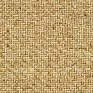
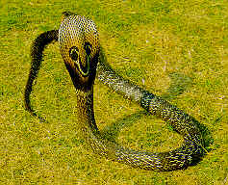
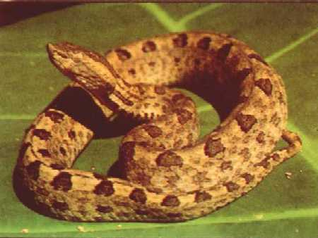
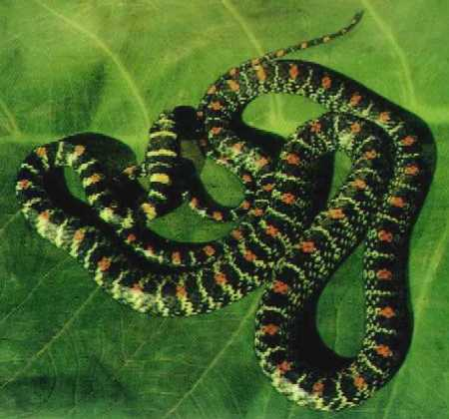
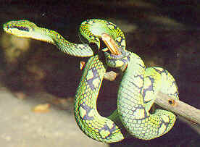
Snakes of Sri Lanka

Slide 2
Scales
Body of the snake is covered with scales
Very important in identification
Number
Size
Colour
Arrangement
Scales of different parts of the body are given
different names

Slide 3
Head scale
Enlarged head scales
Most of the elapids
Most of the non poisonous
Non enlarged scales (shields)

Slide 4
Body scales
Scales covering the body (neck to anus) two types
Tail scales
In sub caudal there are 2 types of arrangement

Slide 5

Feebly poisonous snakes
Rare flanged
Low toxicity
Venom injecting mechanism is relatively
insufficient to inject a sufficient quantity
Produce mild symptoms pain swelling, local,
reactions no fatality

Slide 6
Snakes habits
Carnivorous feed on rats, frog, geodes , lizards bird eggs etc.,
Venomous snakes use their venom to immobilized the prey
Snakes bite when they are bitter – frightened & exited
Non venomous snakes have tooth but no flangs

Slide 7
Character Elapids Vipers
1.Head (a) Shape, like a spoon Taaingular
ie: spatula shaped
(b) Scales – enlarged Small
2.Body slender Stout
3.Tail long Stout

Slide 8
General features
* Belongs to elapidae
* Long snakes, especially the tail
* Head – spatula or spoon shaped
- scales are enlarged
* Vertibrals are also enlarged
* Subcaudals are uniserial
* Oviparous
* Posses grooved flangs
* Venom – neurotoxic
* Corneal - circular
ELAPIDS

Slide 9
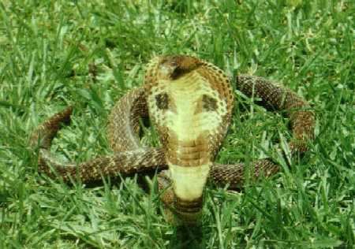
Cobra – Naja naja naja
Long dark brown snake
Active during day time diural
Found all over Sri Lanka
Commonly found near human habitations
Inoffensive snake only attacks if provocated
Attempt to more away from the sight
Lacks most of the features of an elapids
Eg: vertebrals are enlarged
Subcaudale bi-serial

Slide 10
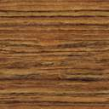
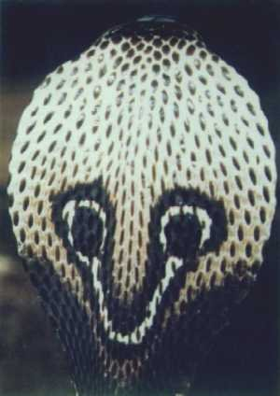
Can be easily identified by the characteristic “ප” like
marking situated on a loose fold of skin on the neck
(of the dossal side)
When excited this fold expands into a hood
Cobra is the only snake to have this

Slide 11
♀ oviparous 12-40 eggs
Young cobra more dangerous
alert
excitable
strikes repeatly
Young also posses venum

Slide 12
Venom - mainly neurotoxic & cardiotoxic
- ¾ of death
Lots of pain swelling local bite below the
knee necrosis
220cm upto 1500cm At the site

Slide 13
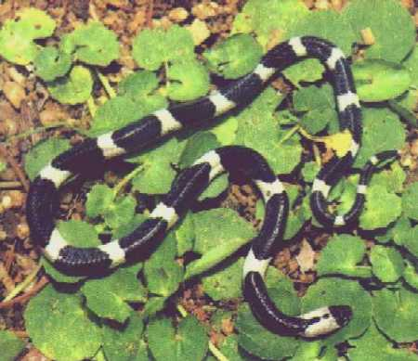
CEYLON KRAIT
Scientific name : Bungarus ceylonicus
Sinhala name: Mudu Karawala (මුඳු කරවලා) English name: Sri Lankan (Ceylon) krait
Average length = 60cm

Slide 14
Prefers cool, moist, habitat (wet & intermediate zone)
Nocturnal snake, day time in & out of houses
Blackish brown snake with white bands on the body
(dorsal surface)
Bands extend to the ventral surface, Others not
(but they are dorsal)
Vertebrals enlarged

Slide 15
Feed mainly on other small snakes
Inoffensive snake – under great provocation
bites
Highly venomous mainly neurotoxic kraits
(Ceylon & India) – 17% death’s
Bites usually little or no reactions

Slide 16
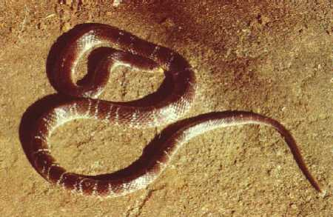
INDIAN KRAIT
Scientific name : Bungarus caeruleus
Sinhala name: Thel Karawala (තෙල් කරවලා)
English name: Indian krait
Average length = 75cm

Slide 17
Bluish black colour snake
It was an oily (glossy) shiney appearance
Has paired white bands on the dorsal surface
Belly is uniformly white
Has general features of an elapid

Slide 18
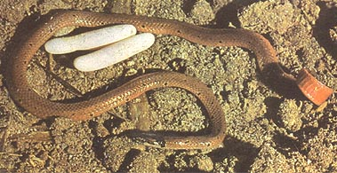
SLENDER CORAL SNAKE
Scientific name : Calliophis melaanurus
Sinhala name: Depath naya (දෙපත් නයා)
English name: Slender Coral Snake
Average length = 30 cm

Slide 19
Vetebrals are enlarged
Mainly found in dry zone :low: countries
In offensive snake – closely associated with
human dwellings
Nocturnal in habitats
Highly potent neurotoxic venonum

Slide 20
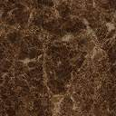
General feature
Short – stout snakes – tail is short
Head – flat triangular
Scales not enlarged
Viviparous
Canalized flanges
Venom – vasculotoxin
(Russell’s viper neurotoxic effects)
Subcoudals biseral
2 types true vipers
pit vipers
Vipers

Slide 21
True Vipers
Russell’s Viper
Saw scaled Viper
Pit Vipers
Green pit Viper
Hump nosed Viper

Slide 22
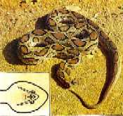
Russell's viper
Scientific name : Vipera russelli Sinhala name : Thith polonga English name : Russell's viper
Average Length = 90 cm

Slide 23
Largest & most widely distributed viper in
Sri Lanka
Found near human habitation
Lazy sluggish snake
Nocturnal in habitats
Triangular head well differentiated neck
2 light colour lines which meet at the tip of
the snout to form a V

Slide 24
Highly poisonous 40% of deaths due to this
snake in Sri Lanka
Attacks on provocation with force &
determination
Movable canalized flangs
Venoum vasculotoxic as well as neurotoxic
Brown in colour, has 3 rows of black elliptical
markings running alone the length of the snake

Slide 25
22-30 sp
Belly is whitish yellow in colour
Size 60cm
Dorsally brown
6-97 youngs
1800m upto
Poisoning effects mainly due to neurotoxic

Slide 26
Without loreal pits
With loreal pits
Sub caudals are divided
Vipera russelli
Russels viper
Head scales enlarged
Hypanale hyp
Hypanale nepa
Humpped nosed viper
b) Sub caudals are undivided
Echis carinatus
Saw scaled viper
b) Head scales not enlarged
Trimensuru trig
Green pit

Slide 27
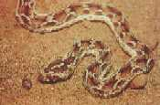
Saw scaled viper
Scientific name : Echis carinata carinata Sinhala name : Veli polonga (v#Ä @p`lg`) English name : Saw scaled viper

Slide 28
Small viper 25cm
Very active, vicious aggressive snake
Sandy brown in colour
White cross or birds foot mark over the dorsal
surface of the neck
Strikes on slightest provocation
When disturbed, it rubs the coils against each other
producing a hissing noise (characteristic)
Found in the north & eastern costal region of
Sri Lanka

Slide 29
Pit vipers
There is a pit (loreal – pit) situated between the
eye & nostrils
This is a thermoreceptive organ that help the
snake to detect the warm blooded prey from the
distance in darkness

Slide 30
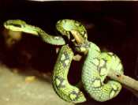
Green pit viper
Scientific name: Trimeresurus trigonocephalus Sinhala name : Pala polonga (pl` @p`l<`)
English name : Green pit viper Average Length = 750 mm

Slide 31
Bright green in colour with black markings
Arboreal nocturnal snake (associated with trees)
Sluggish snake – strikes when aroused
Common in rain forest area, plantations etc.
Venom causes local pain & swelling no
reported deaths. (No fatalities)
Have general features of a viper
No. hump, vertebral small, subcaudals - biserial

Slide 32
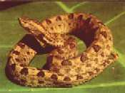
Hump nosed viper
Scientific name : Hypnale hypnale Sinhala name : Polonthelissa, Kunakatuwa English name : Hump nosed viper Average Length = 375 mm

Slide 33
Widely distributed in Sri Lanka. Very common in
this area – Galle
Brown in colour with dark brown & black
markings, highly variable colour variation
Nocturnal snakes hide under leaves stones
during day time
Fatal cases – so far reported causes severe
local reactions pain & swellings – antibiotics +
paracetomol sufficient

Slide 34
Characteristic feature is the upturned shout
(hump)
Dorsally grey yellow brown to salmon pink in
colour
Unlike other vipers – head scales are enlarge,
closely resembles the cat snake m`Ól`
Fatalities

Slide 35
Other common snakes
Family – colubridae (colubrides)
This family comprises the largest group of the
snake sp in this country
47sp belong to this family. Majority non-poisonous
11sp rear flanged feebly poisonous
Commonly encountered
Some feebly poisonous snakes
These snakes are nearly all diurnal very active
with large heads & eyes

Slide 36
Feebly Poisonous Snakes
Eg: Cat snake m`Ól`
Whip snakes a#h#éLl`,a#S²Ll`

Slide 37
Genus – Boiga
Arboreal , nocturnal , active snakes
There venum is feebly toxic cause local effects
Rear flagged
4 sp. found in Sri Lanka
2 common sp. Boiga forsteni (largest)
Boiga ceylonesis (commonest)
They mimic the vipers specially the hump nosed viper
Eyes large with vertical pupil is called cat snake
Lump shaped markings on occiput

Slide 38
External appearance
Long snake, no lump, no loreal pit
Long tail
Head, spatula shaped
Large eyes
In Sri Lanka believed to be deadly poisonous
cat snakes are usually found in pair

Slide 39


Whip Snake
Scientific name : Dryoptis nasutus
Sinhala name : Ahaetulla
English name : Whip Snake

Slide 40
Arboreal, diurnal, active snakes
Bright green in colour
Fierce & vicious snake
Head shape – very characteristic
Longer, narrow acutely pointed snout

Slide 41
Venom feebly toxic-local reactions colouration &
shape
Excellent common flage (can hide easily)
Believed to strike at the eye
(Sinhalese nake false belief)
Non poisonous Colurbrides Commonly found in
Sri Lnka

Slide 42
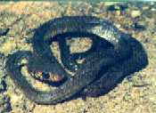
Rat Snake
Scientific name : Coluber mucosus maximus Sinhala name : Garendiya (g#r«y`)
English name : Rat Snake

Slide 43
Common non-poisonous snake
Largest colabrides in Sri Lanka
Found in & out of houses
Diurnal, alert & active
Fierced when provoked
Colour vary – green, brown, yellow
Sometimes resembles cobra
(eyes are larger than cobra)

Slide 44
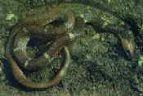
Ceylon Wolf Snake
Scientific name : Cercaspis carinatus
Sinhala name : Dara Karawala (q`r krvl`)
English name : Ceylon Wolf Snake

Slide 45
Rather common snake
Resembles the Ceylon krait
Vertebrals not enlarged
(only different to Ceylon krait)
Sub caudals unisearial
Get the bands in belly

Slide 46

Common Wolf Snake
Scientific name : Lycoden aulicus
Sinhala name : Kunu Mee Karawala
(ÁÈÊ krvl`)
English name : Common Wolf Snake

Slide 47
Very common, nocturnal, non-venomous snake
Resembles the ceylon krait
Vertibral are not enlarged
Belly is white
Sub caudals divided
White bands on the dorsal surface but does
not extend to the ventral surface

Slide 48
Diurnal, gentle, non venomous snake
Commonly seen
Two yellow or buff colour dorsolateral
stripes run from neck to fail tip
Rough saled

Slide 49
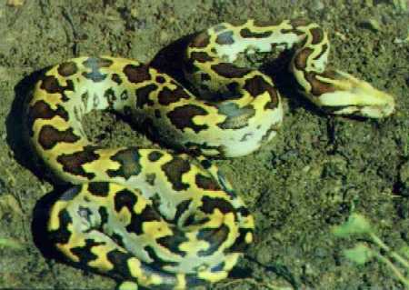
Python
Scientific name : Python molurus molurus
Sinhala name : Kunu Mee Karawala
(ÁÈÊ krvl`)
English name : Python

Slide 50
Family – baidae
Only sp in Sri Lanka
Large snake with massive cylindrical
bodies
Non venomous
Kill the prey by constricting
Body has 3 rows of quadrate markings
Young python resembles the russel’s
viper

